Slide 1
CONNECT-FOUR
TEAM INFINITY
Osama Iskandarani
Ayla Hmadi
Iyad Al-Arab
Mohamad Chaaban​

Slide 2
OUTLINE
Introduction​
Mini-Max Algorithm
Algorithm Functionalities
Implementation
Testing Strategies
​Summary​

Slide 3
Introduction
PHASE 1:
Developed algorithms to determine the input’s location inside the 2D Matrix
Created an atomic clock to measure the average time taken by each player in order to give the game a better experience
PHASE 2:
Implemented the Mini Max Algorithm in order to develop the bot’s AI via developing score systems to find optimal moves
Utilized the Mini Max Algorithm’s depth system in order to lower or increase the AI’s predictions of the player’s inputs, and thus to change difficulties

Slide 4
MINI-MAX Algorithm
An Efficient Decision Tree-Based Algorithm used in Game Theory

Slide 5
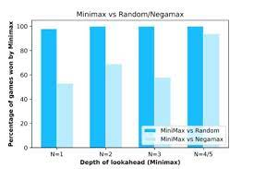
WHY MINI-MAX
By: Mili Publications, India

Slide 6
MINI-MAX FUNCTIONALITY
A depth-limited minimax algorithm only considers a predetermined number of moves in the future. Without a depth cap, the program would follow every move all the way to victory. This can easily become computationally unsolvable for all games but the most basic ones. For instance, the player might have a number of options, and for each of them, the opponent might have a number of options, and for each of their options, the player might have a number of further options .

Slide 7
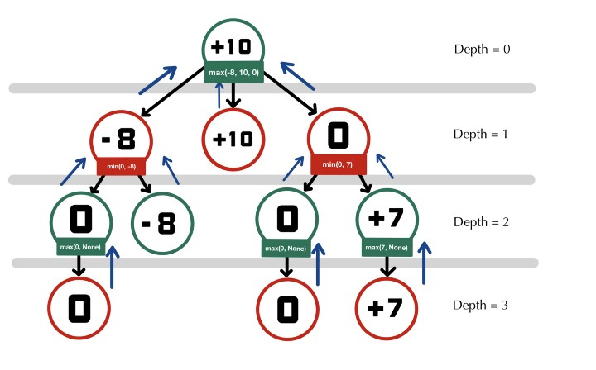
Logical Example
BY: becominghuman.ai

Slide 8
Implementation
Create temporary matrices that compare the scores on the board in order to determine where the bot will either block the player or place a winning move
The ability to determine and predict the player movements up to x times, where x increases as the depth of the matrix feature increases.
Check for the winner of the game by having either 4 adjacent player moves, of 4 adjacent bot moves (horizontally, vertically, and oblique).

Slide 9
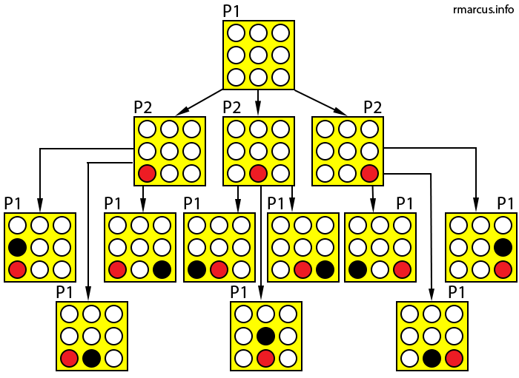

Slide 10
TESTING STRATEGIES
Avoid increasing the depth to a large value in order to avoid performance issues & lag
Input at the middle of the board to make it easier to win the game
Mix between inputting horizontally, vertically, and diagonally to test the bot’s input system
Race to place multiple inputs adjacent to each other to test the bot’s blocking mechanics
Race to block the bot’s latest input in order to test the bot’s optimal move AI

Slide 11
ALGORITHMS COMPARED
Monte Carlo
Mini Max
Slower Time Efficiency
Best used for Easy Modes
Good for randomization
Faster Time Efficiency
Used for Harder Modes
Good for Advanced AI Logic

Slide 12
SUMMARY
Mini Max Algorithm is a fast, more optimized, and better to use when it comes to the bot’s logic, depth analysis and time efficiency.
Mini Max Algorithm’s own depth feature can either upgrade or downgrade the bot’s level of logic.
For Testing, it is best to try to block the bot’s moves or place adjacent winning inputs in order to immediately test the AI’s logic without wasting time.

Slide 13
THANK YOU
TEAM INFINITY
CMPS 270: SOFTWARE CONSTRUCTION
AMERICAN UNIVERSITY OF BEIRUT (AUB), BEIRUT CAMPUS

